Slide 1
Rev. 1.15
Hours of Service (HOS) Mobile APP©
Driver’s Guide Booklet
INTRODUCTION AND COMPLIANCE
The latest HOS Mobile APP, released on the first half of 2015, is complaint with US Federal FMCSA title 49 part 395 AOBRD 395.15, 395.16 and the latest modifications to the rule including the current suspension of the two 1am to 5am OFF duty periods for the 34 hours restart.
There is Certification menu option that indicates that the mobile APP, mobile device used were self-certified according to federal requirement.
The driver's log file exported by the mobile APP is generated according to the latest ELD data element dictionary released by FMCSA.
Regulations the mobile APP is compliant with:
- 60-hour/7 days or 70-hour/8 days Rules
- 34 hour week restart with latest suspension of two periods 1-5am
- 11 hours driving for the day
- 14 hours on duty for the day
- Sleeper Berth provision
- Passenger Seat provision
Personal Conveyance provision
30 minutes break provision
Canada Cycle 1 and 2 Regulations
- Location recording for vehicle’s engine turned on and off, and location recording every 60 minutes if vehicle is moving
- Mobile device permits duty status changes only when the vehicle is at rest
- The mobile device warns the driver, visually and/or audibly of any malfunction
- When the vehicle is stationary for 5 minutes or more, the mobile device will default to on-duty not driving and the driver must enter the proper status
- The mobile device (ELD) performs self-test, as well as a self-test at any point upon request of an authorized safety assurance official
The HOS Mobile APP is not compliant for (exclusions):
- Passenger-carrying vehicles
- States of Hawaii and Alaska
p.2
Contents
page
Introduction and compliance . . . . . . . . . . . . . . . . . . . . . . . . . . . . . . . . . 2
Self-certification . . . . . . . . . . . . . . . . . . . . . . . . . . . . . . . . . 3
Account types (driver, support personnel, non-authenticated) . . . . . . 3
LOGGING ON
Driver login and Support Personnel . . . . . . . . . . . . . . . . . . . . . . . . . . . . 4
Bluetooth device discovery and pairing. ELD diagnostic . . . . . . . . . . . . 4
DRIVER’S ACTIVITIES - BEFORE CHANGING DRIVER STATUS
Vehicle profile . . . . . . . . . . . . . . . . . . . . . . . . . . . . . . . . . 5
Driver’s profile. Team drivers . . . . . . . . . . . . . . . . . . . . . . . . . . . . . . . . . 5
Creating shipments . . . . . . . . . . . . . . . . . . . . . . . . . . . . . . . . . 7
Assumption of unidentified records . . . . . . . . . . . . . . . . . . . . . . . . . . . . 7
Malfunction/Diagnostic indicators . . . . . . . . . . . . . . . . . . . . . . . . . . . . . 8
WORKING WITH THE APP AND CREATING DRIVER LOGS
Personal use, yard moves and exemptions . . . . . . . . . . . . . . . . . . . . . . 8
Changing driver’s status and Principal screen . . . . . . . . . . . . . . . . . . . . 8
Remaining times . . . . . . . . . . . . . . . . . . . . . . . . . . . . . . . . . 9
Violations (proactive notifications and occurrence) . . . . . . . . . . . . . . . 9
Reviewing, editing and certifying driver’s logs . . . . . . . . . . . . . . . . . . . 10
Creating annotations . . . . . . . . . . . . . . . . . . . . . . . . . . . . . . . . . 11
Logs chart . . . . . . . . . . . . . . . . . . . . . . . . . . . . . . . . . 11
LogBook and Exporting Driver’s Logs (Print/Display and . . . . . . . . . . . 11
Data file transfer)
p.1

Slide 2
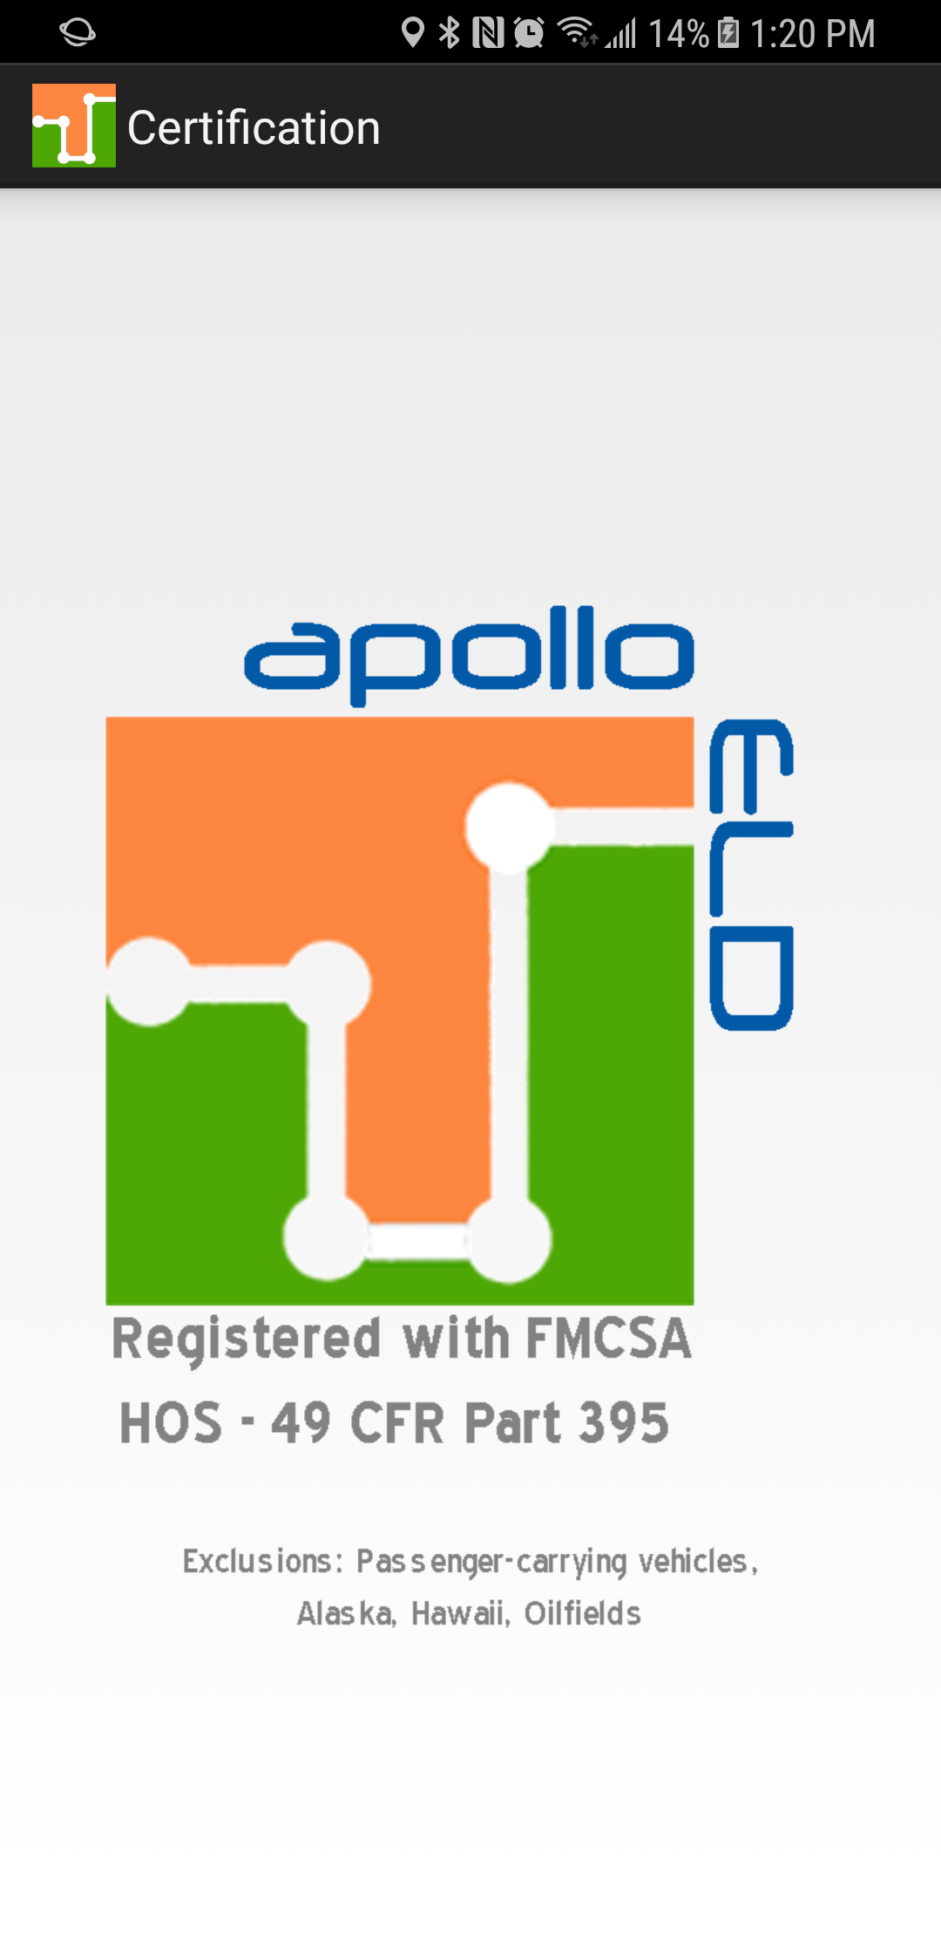
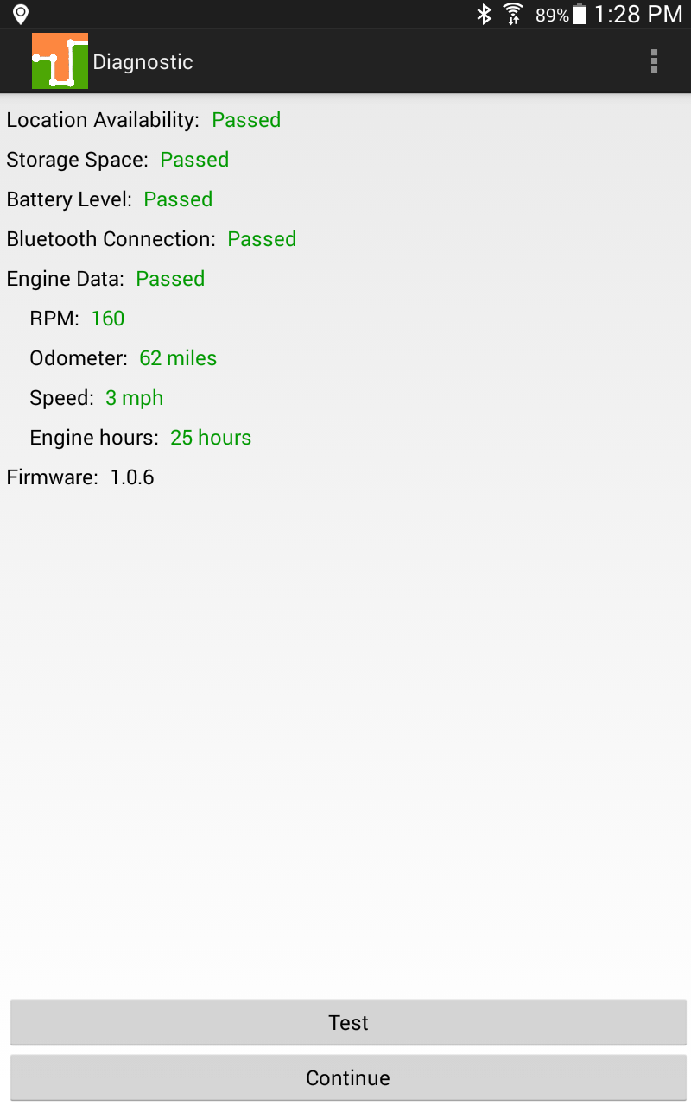
FMCSA REGISTRATION
As a substitution to an exterior faceplate, a “Certification” menu item will display the certification image as evidence that the mobile device has been tested, certified and approved as meeting the performance requirements.
ACCOUNT TYPES
Driver: Unique, per-driver account used by drivers under 49 CFR Parts 385, 386, 390, and 395 regulations (hereon HOS). This account records duty status changes (RODS) and allows the export of driver’s records for display, print and agent output file generation.
Support: Account used by the carrier and ELD manufacturer to setup, configure, update and troubleshoot the ELD. No duty status changes are recorded with this account and no access to driver’s record of duty status changes is permitted under the support account.
Non-authenticated: All operation of a commercial motor vehicle (CMV) is recorded under this account (a.k.a Unidentified Driver) if no driver has logged into the ELD. Non-authenticated records (vehicle movement and on-duty time) are stored on the ELD as well as the carrier and should be assumed by a driver account.
p.3
SUPPORT PERSONNEL
Bluetooth discovery and pairing. ELD Diagnostic
When an ELD is installed, support personnel must do the initial configuration and diagnostic of the ELD. From the login screen select the Support option from the menu (top right corner). The support personnel will scan for ECM-Link devices. Once the ECM-Link device shows in the screen, tap on it and a diagnostic will be performed on the EDL to make sure all necessary functionality is available. Once the diagnostic passes, the ELD is ready for driver operation. In order for the ELD to be compliant several parameters must be acquired from the vehicle’s Engine Control Module (ECM) and other internal systems have to be verified.
During the diagnostic, the mobile APP will begin collecting the necessary engine data. Support personnel can only release the ELD for driver use after all ELD diagnostics were successfully performed:
DRIVER LOGIN
Each driver using the system will have a unique login ID. This login name and password is for the specific driver’s use only and must not be shared with any other person (driver or not). The login name belongs to the driver and is linked to the driver’s personal information (e.g. driver’s license, etcetera). If the driver changes carrier and is now driving for a different carrier, the login name will remain the same and is the driver’s obligation to ask the home base carrier to update carrier name and DOT number on the system.
p.4

Slide 3
The driver is restricted to be logged on to only one mobile device at any time. In order for the driver to logon on a different mobile device, the driver must change to off duty status and logout from the previous device.
Driver’s login unlock. In an event the driver is still logged on a device but the device ceased to function or gets lost, the driver must call the home base carrier and ask for his login name to be unlocked. The unlock process will change the driver’s status to off duty at the time the driver solicited the login unlock and will deregister the old mobile device from the system in order to let the driver log on a different mobile device.
This process can also be made, at any time, by a driver in case the driver switch trucks or a Diagnostic/Malfunction indicator is turned red (go to the Menu and select Diagnostic).
VEHICLE PROFILE
Before driver’s logs can be exported and shared with an authorized agent, the driver must update the correct vehicle’s information.
Please enter the correct tractor number, trailer number, tractor VIN number as well as the odometer reading on the truck’s dashboard . Select the “Vehicle Profile” option from the menu.
DRIVER PROFILE AND TEAM DRIVERS
We recommend to verify the driver's profile. Please make sure the information is correct: carrier name, your rule set (60-hour or 70-hour) and the home base time zone.
p.5
Select the Rule Set drop-down to change rule set from 60h to 70h and vice versa.
p.6

Slide 4
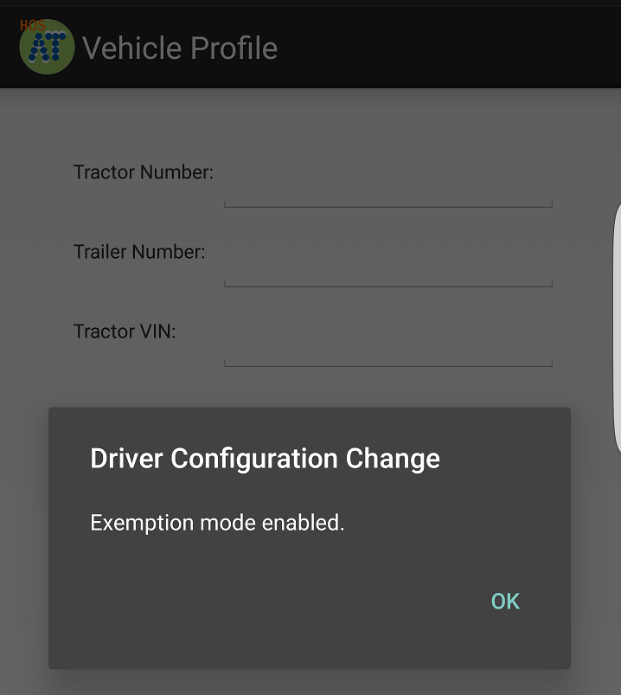
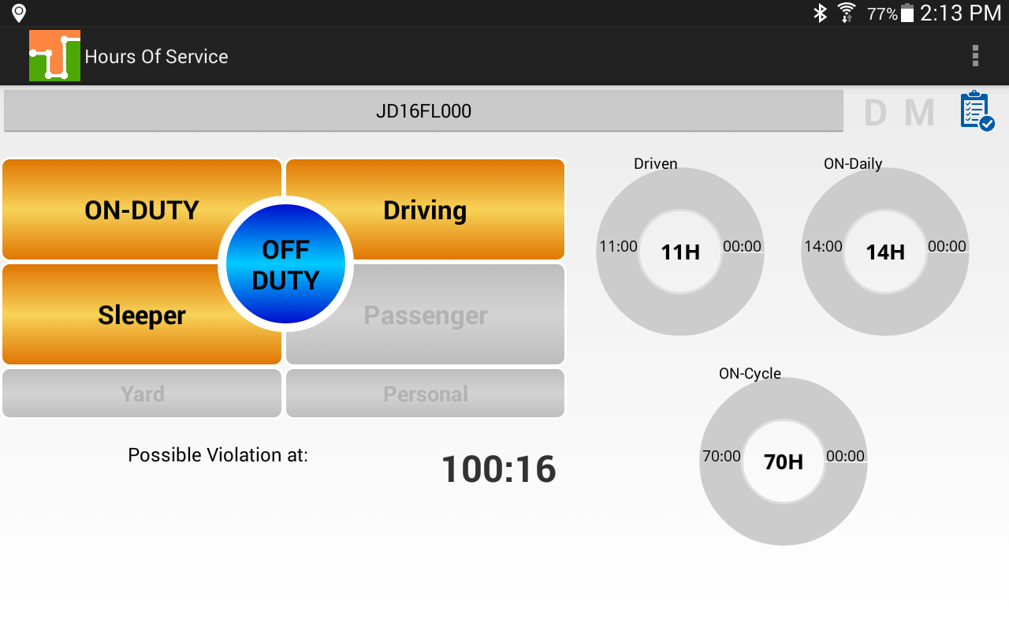
Team drivers: Up to two drivers are allowed to log on the same mobile device. Records and logs are generated for each independent driver showing the other driver as co-driver.
To logon a second driver just tap on the name of the currently logged driver on the APP’s Principal screen.
CREATING SHIPMENTS
The driver should create a shipment on the mobile APP. Please select the option “Shipment” from the menu. Make sure you enter the correct shipment’s pick-up and delivery time, as well as the shipper name, shipment number and the commodity you are transporting. The information provided here must match the driver’s supporting documents.
ASSUMPTION OF UNIDENTIFIED RECORDS
The ELD is designed to record all vehicle movements and stop time during movements on an un-authenticated account. Please, during the login process, accept the unidentified records that belong to you by tapping on the checkboxes and then selecting “Accept selected records”.
p.7
MALFUNCTION/DIAGNOSTIC INDICATORS
If the M (malfunction) or D (Diagnostic) indicators, located on the top right corner of the ELD turn red please contact your support personnel . This is an indication of an ELD failure an requires immediate attention. To identify the specific ELD malfunction run the Diagnostic option on the main Menu.
PERSONAL USE, YARD MOVES AND EXEMPTIONS
There are 3 ELD operational modes that have been added to help drivers on specific scenarios. These 3 modes are activated only by the carrier and will be shown during the login and logout process.
CHANGING DRIVER STATUS AND PRINCIPAL SCREEN
The Principal screen Is where duty status changes are made. There are five different options for the driver to pick from. Besides the normal duty status, the mobile APP includes support for Personal Conveyance and Yard
Moves.
p.8

Slide 5
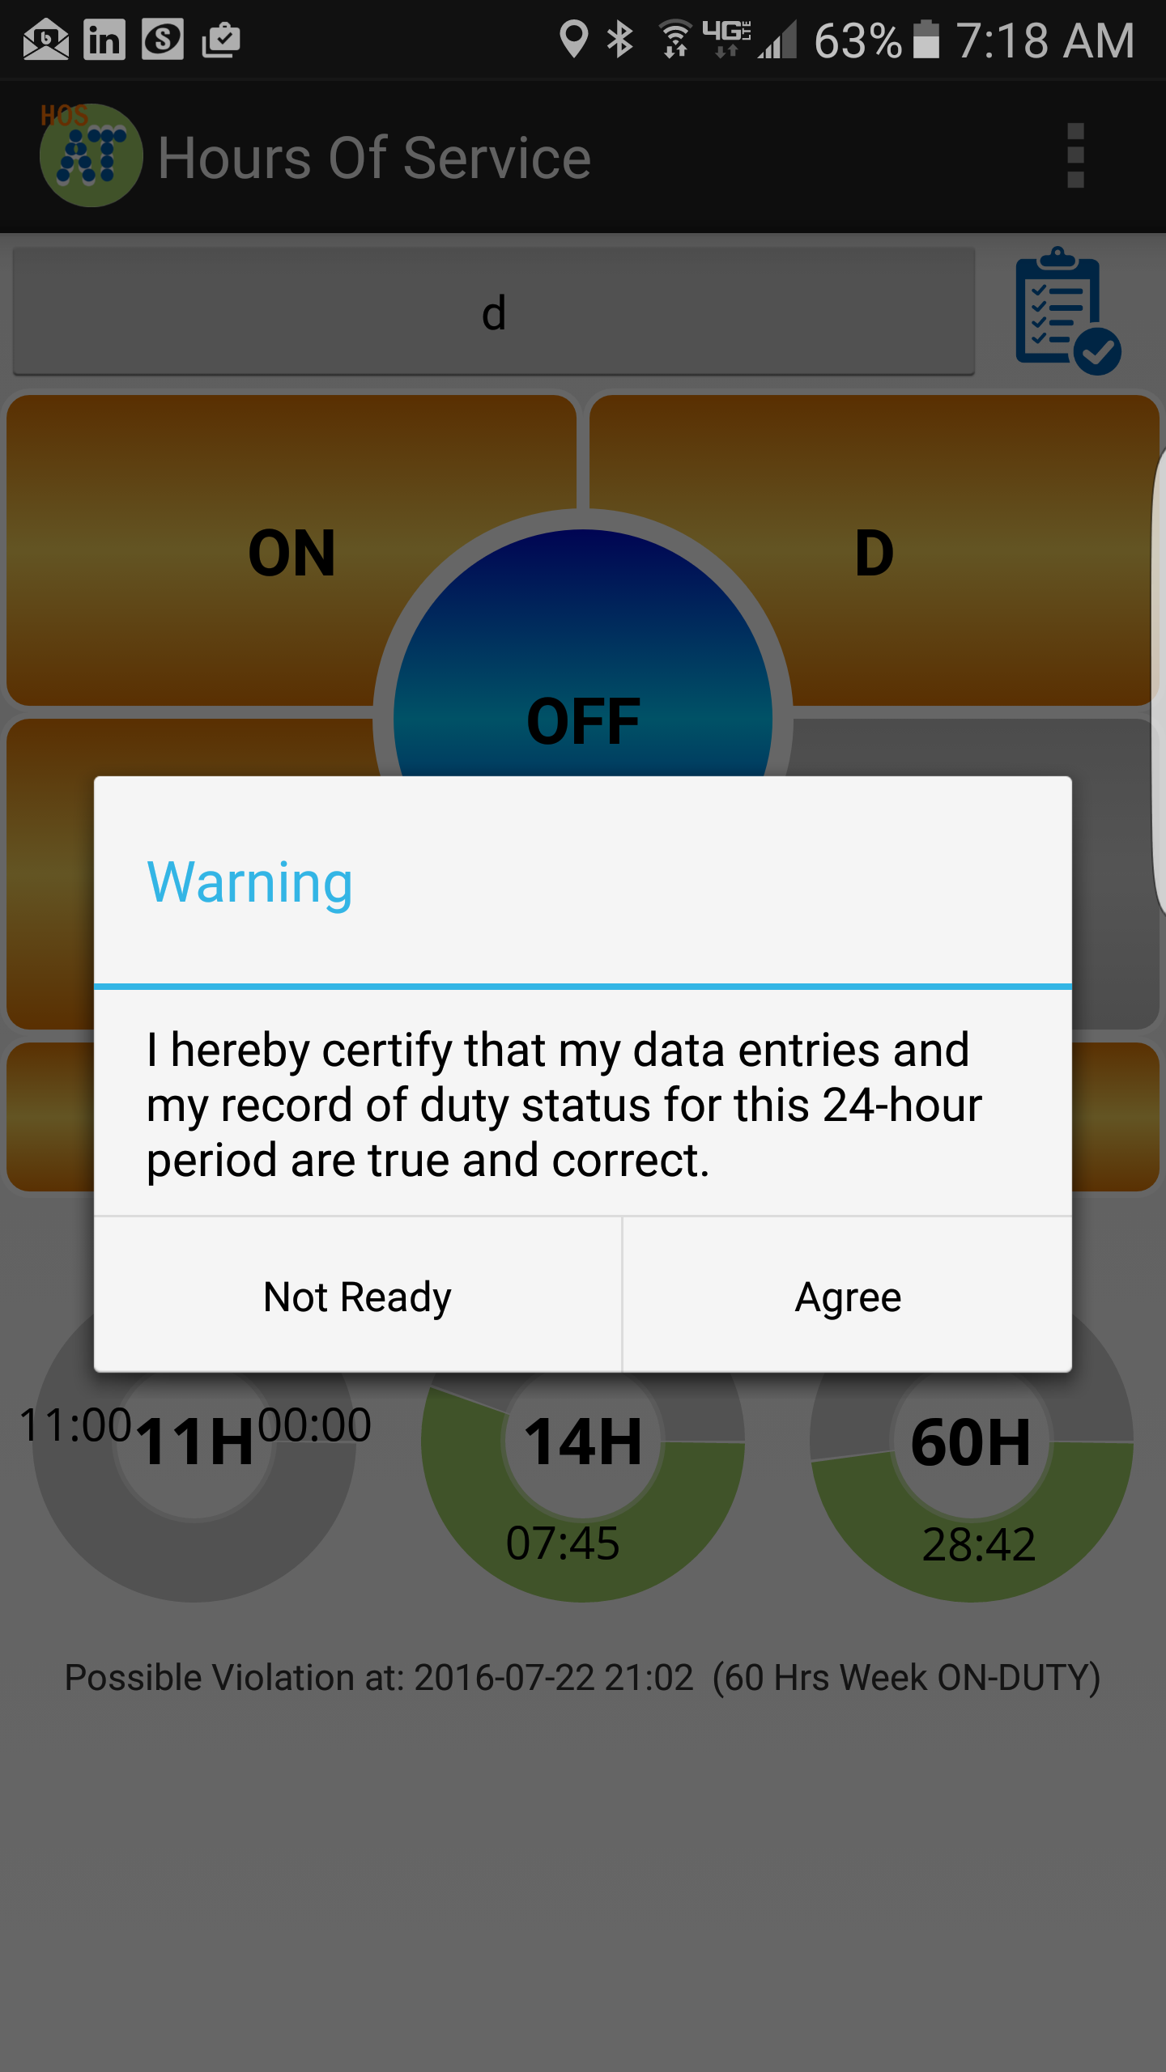
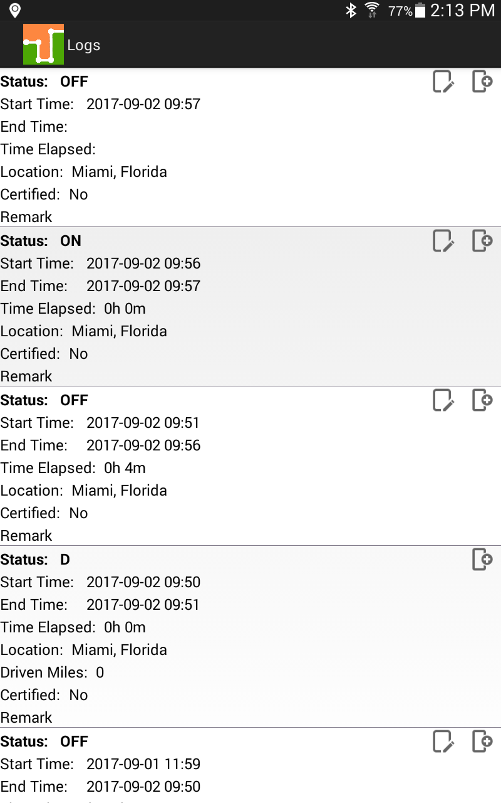
The mobile APP also keeps track of possible violations under the “Remaining” session.
Please tab on any of the following duty status:
ON -- on duty status
D -- driving status
SB -- sleeper berth
PS -- passenger seat
Personal -- for personal conveyance (use)
OFF – off duty status
REMAINING TIMES
The mobile APP automatically calculates the different times at which a violation will take place. The time spent on the current duty status us is also shown (on this picture: 100 hours and 16 minutes)
VIOLATIONS (PROACTIVE NOTIFICATIONS AND OCURRANCE)
The mobile APP automatically calculates the different times at which a violation will take place. For every possible violation a visual notification is generated so that the driver becomes aware of the upcoming violation and takes preventive action. This notification is generated 30 minutes before incurring in a specific violation. The driver is also notified right after a violation took place. Please, we recommend to frequently check the “Remaining” session on the Principal screen to remain aware of remaining driving time.
p.9
REVIEWING, EDITING AND CERTIFYING DRIVER LOGS
Every duty status change must be certified before exporting the driver’s logs. Select the “Certify Logs” option from the menu to list all unverified logs. Select each day and tap on the “Certify” button. At the end of each 24-hour period, the ELD will automatically prompt the driver to certify logs for the last 24 hours period. During driver login and logout, the driver will be prompted to certify the logs.
To edit your logs or accept/reject carrier proposed changes go to the “Logs” option in the menu. Tap and hold the log you want to edit. Tap on the log edit button, make and confirm changes. You must enter the reason for the change.
p.10

Slide 6
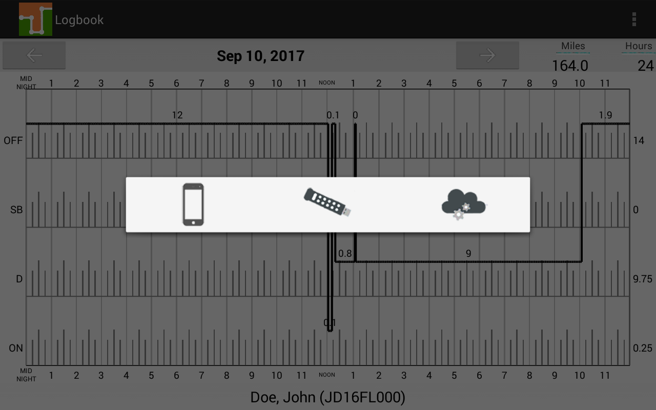
CREATING ANNOTATIONS
The driver can create annotations in order to note changes to previous status.
To create an annotation: tap on the “Logs” option in the menu. You will see a list with all different status changes. Tap on the annotation icon for the log you want to add an annotation to. Enter a text explaining the annotation.
To view existing annotations: Tap on the “Annotations” option in the Principal’s screen menu.
LOGBOOK AND EXPORTING DRIVER LOGS
You can generate a chart with your logs at any time. Tap on the “Logbook” option from the menu. Use the right/left buttons to select a different day.
If an authorized federal agent request to see the driver’s logs, select the option “Export ELD Data File” from the Loogbook menu. The Driver Logs file is automatically created in directory “HOSFolder” inside the mobile device internal storage. Please use the appropriate USB cable to connect the mobile device to the federal agent’s computer/laptop or to USB memory stick (A-type). You can also email the “ELD Data File” to an email given to you by the authorized agent. Please, use your email mobile app of preference taking into consideration that the data file is in HOSFolder. The data file is the only CSV file located in the HOSFolder.
You can also display or print the Logbook by selecting “Print-Display Logs” option. In this case, you can print the PDF file saved on the HOSFolder.
p.11
When selecting “Export ELD Data File”, three different options are shown:
The first option is save the ELD data file locally on your phone/device. The data file is the only CSV file located in the HOSFolder.
The second option is used during roadside inspection and the ELD data file is saved on the DOT external storage device. A validation is first made to confirm that the attached external storage is a valid, FMCSA-defined, device.
The third option is to send the ELD data file to FMCSA’s public webservice.

